Slide 1
Somewhat documenting the iterations over the processing of the MCF10A scRNAseq dataset
Marion Hardy
Albeck lab
Spring showcase 2024

Slide 2
But first a small explanation on cellxgene
1. Introduction
http://169.237.24.172:5005

Slide 3
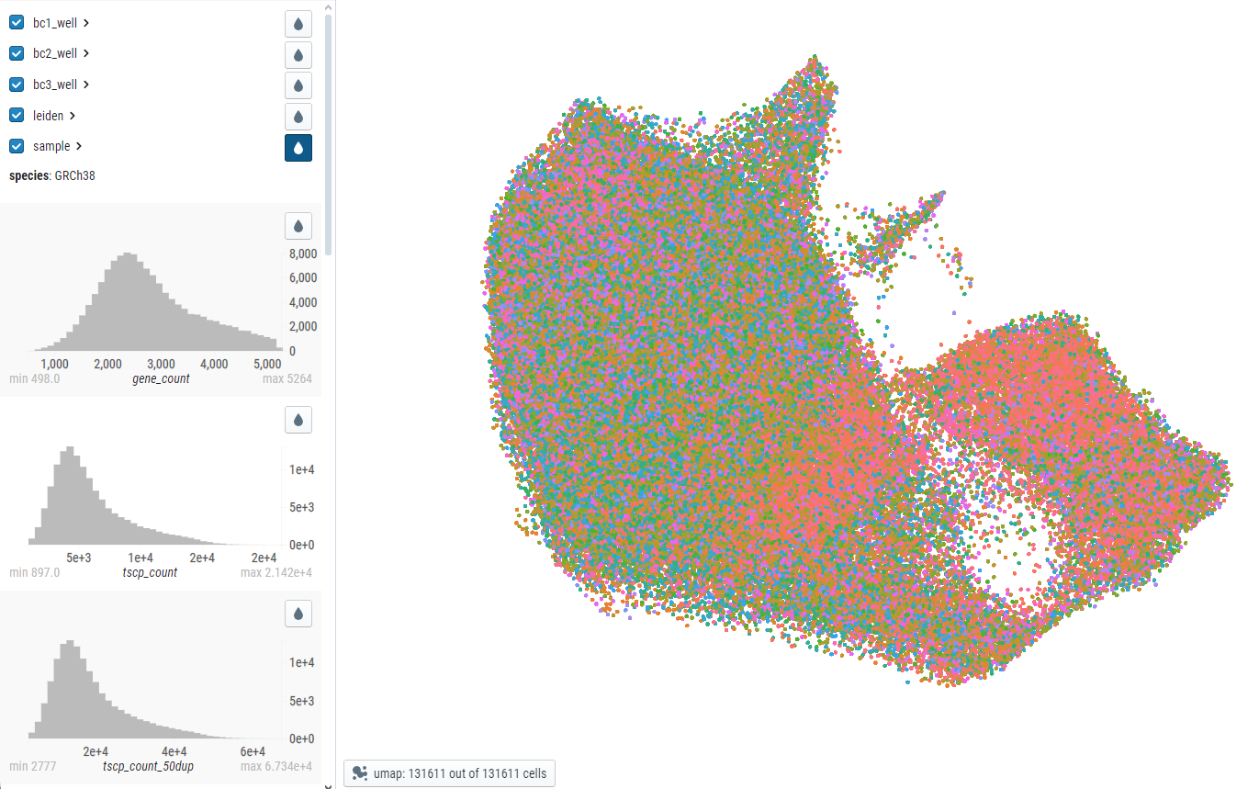
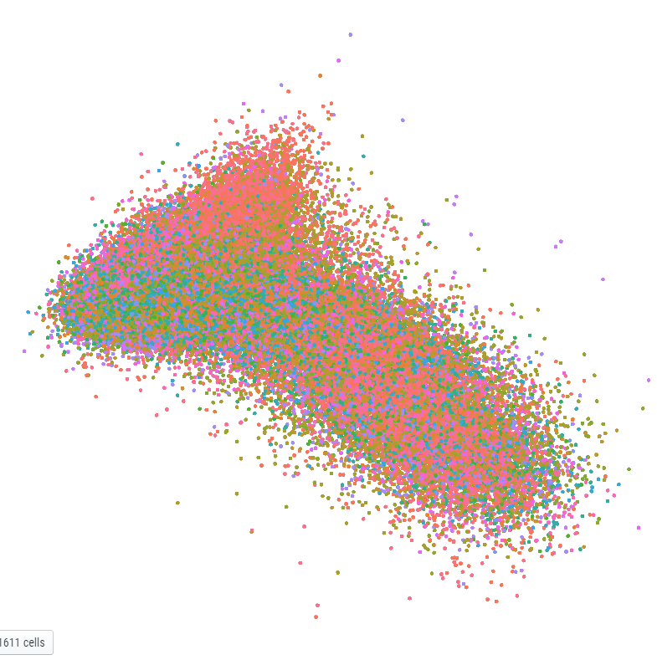

The original slug <3
1. Introduction
http://169.237.24.172:5005/view/Old_Data/all-data.h5ad/
UMAP
PCA
This data was processed using most of the pipeline delineated on parsebiosciences. It used scanpy and mostly default parameters to produce a .h5ad file compatible for cellxgene. There was no filtering out of cells with high mitoch %.
I believe the findvariable genes was too stringent and the normalization could have been better. It was something like sc.log10 then sc.normalize.

Slide 4
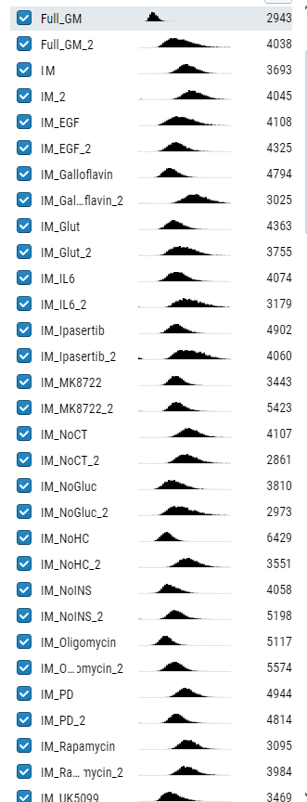
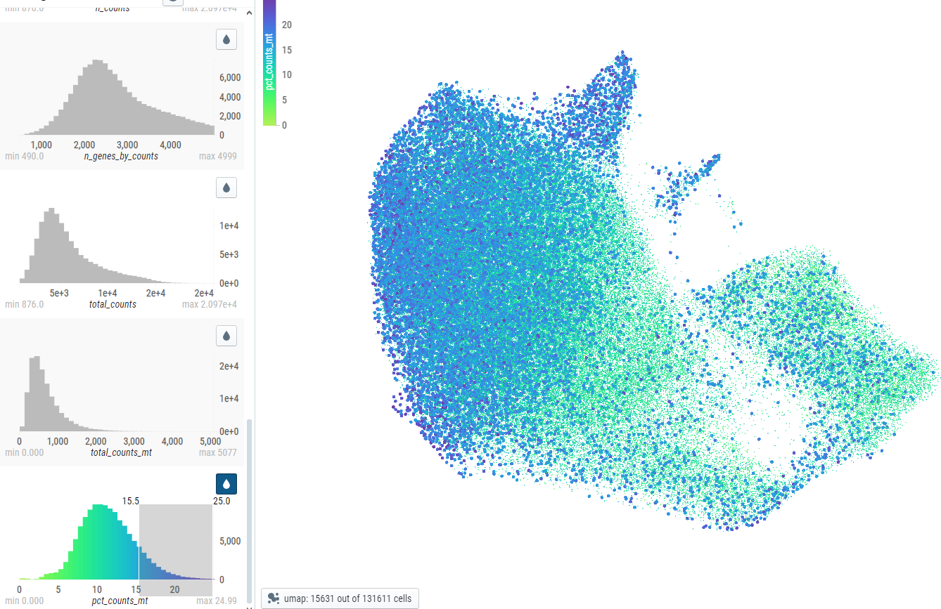
The original slug : % mitochondrial counts
1. Introduction
UMAP

Slide 5
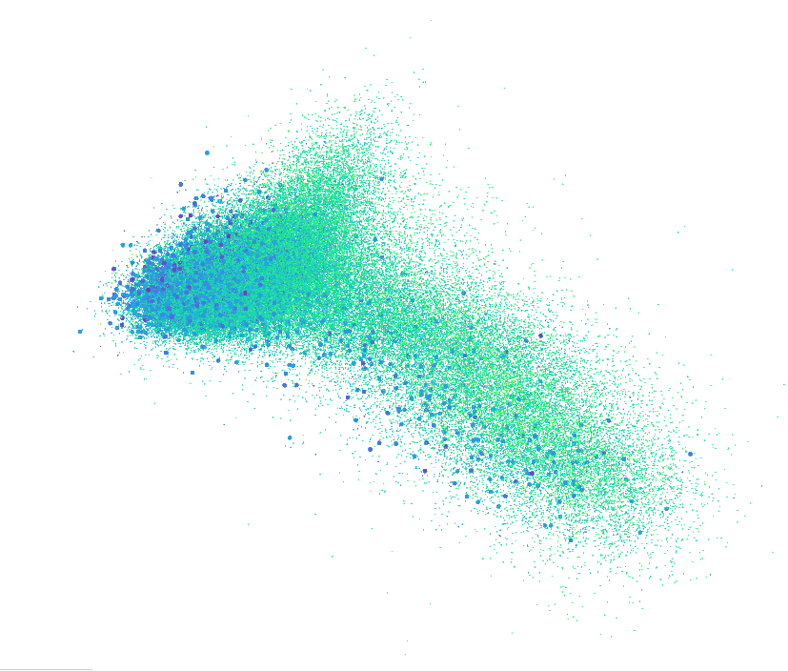
The original slug : % mitochondrial counts
1. Introduction
PCA
Two problems here:
The PC1 seems to mostly be determined by high mitochondrial gene % content
The batches have very different distributions

Slide 6
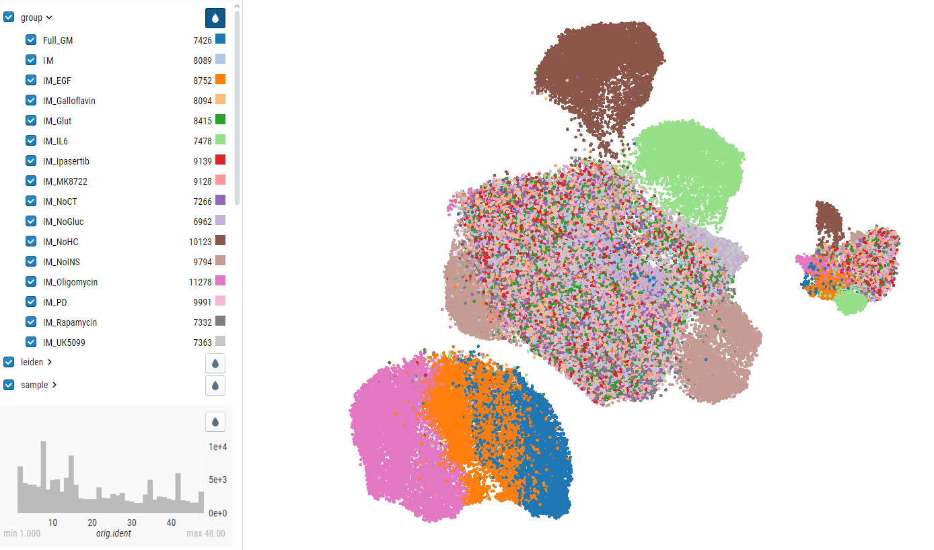
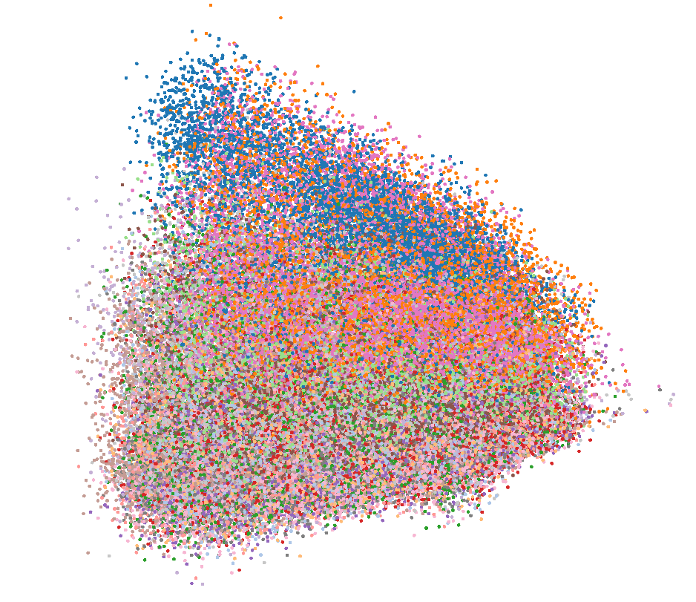
Bibbendum: scanpy pipeline v2
1. Introduction
http://169.237.24.172:5005/view/all_adata_scaled.h5ad/
UMAP
PCA
This data was processed using the original pipeline from Nick but using the data scaled in Seurat (SCTransform) to get the negative binomial distribution and the variance stabilization. So we built the scanpy Anndata by putting scaled data in adata.X then copying to adata.raw. It’s… not the cleanest way to do this but the UMAP is much improved.

Slide 7
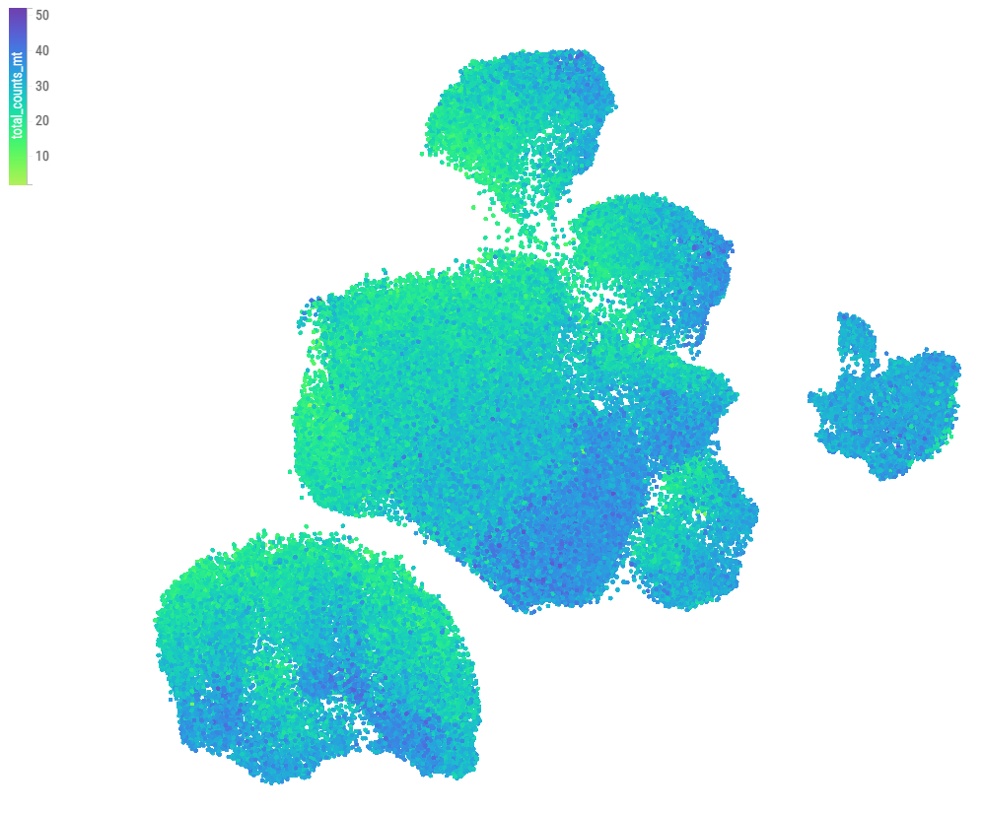
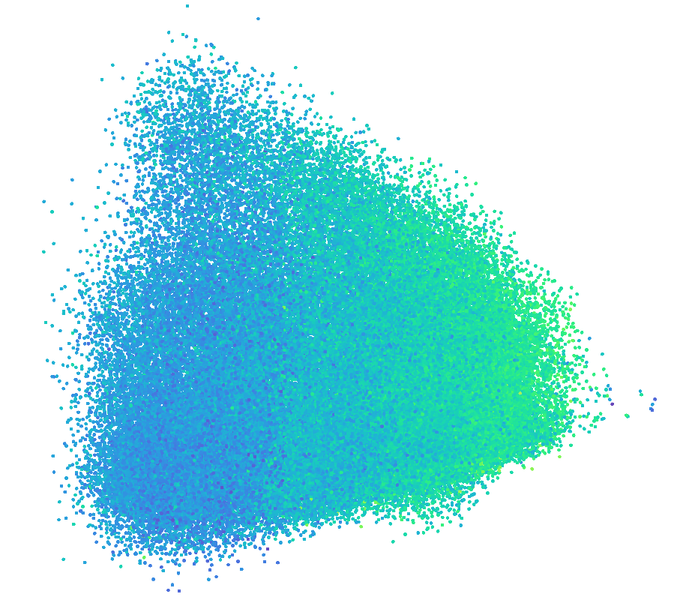
Bibbendum: scanpy pipeline v2, % mitochondrial counts
1. Introduction
http://169.237.24.172:5005/view/all_adata_scaled.h5ad/
UMAP
PCA
This data was processed using the original pipeline from Nick but using the data scaled in Seurat (SCTransform) to get the negative binomial distribution and the variance stabilization. So we built the scanpy Anndata by putting scaled data in adata.X then copying to adata.raw. It’s… not the cleanest way to do this but the UMAP is much improved.
Missing: Batch regression, mitochondrial filtering, raw data for the visualization plugin.

Slide 8
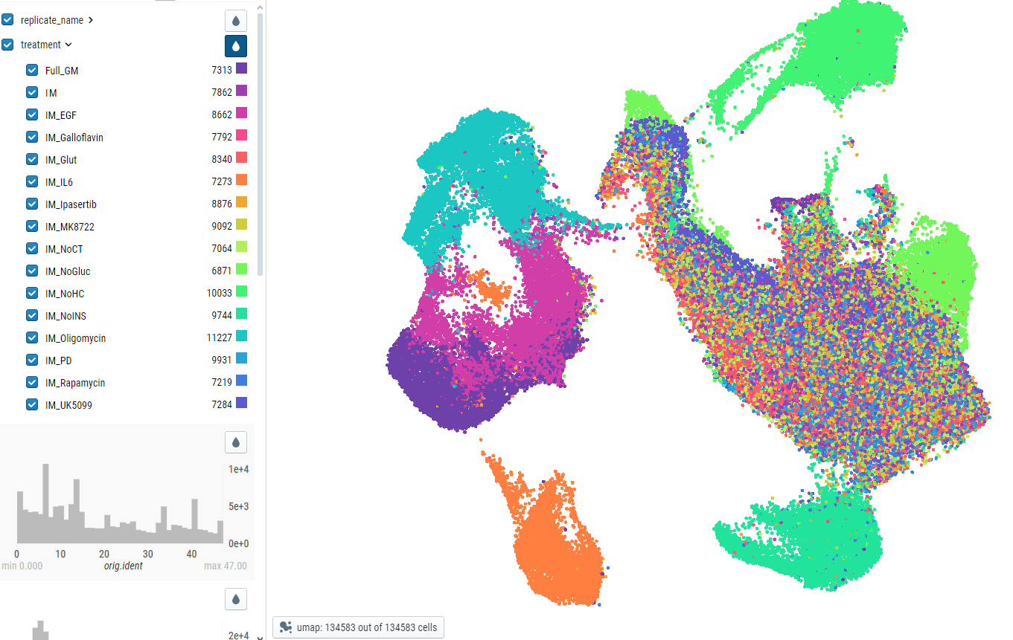
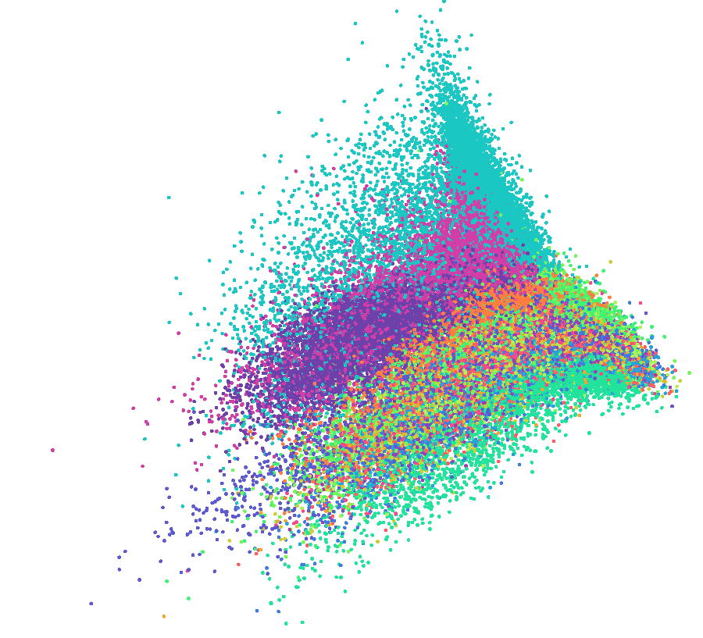
Koi Fish: Seurat full pipeline converted to h5ad
1. Introduction
http://169.237.24.172:5005/view/all_data_scaled_seurat.h5ad/
UMAP
PCA
This data was processed entirely using Seurat v5 then was converted to h5ad using the SeuratDisk package.
Missing: Batch regression, for some reason it didn’t look right when I tried it but I may have made a mistake. Otherwise, I shouldn’t regress for batch, maybe have the batches on different layers and integrate? V5 is too recent to try to do that.

Slide 9
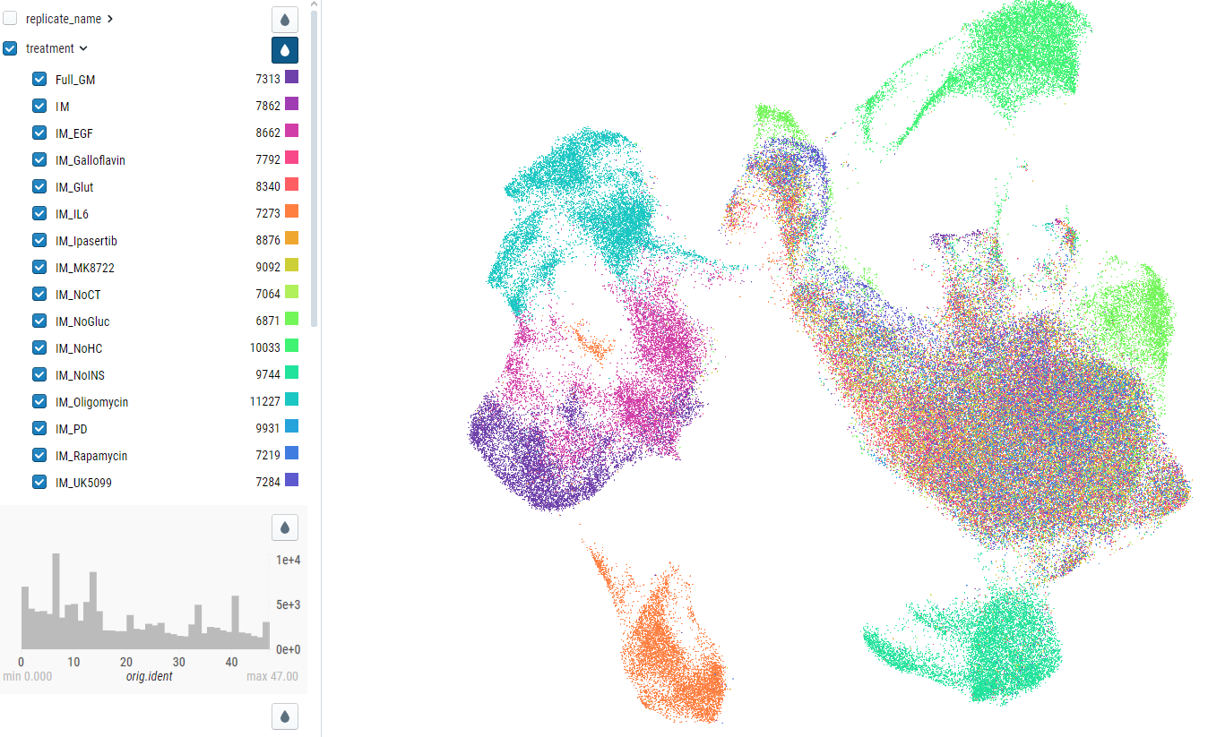
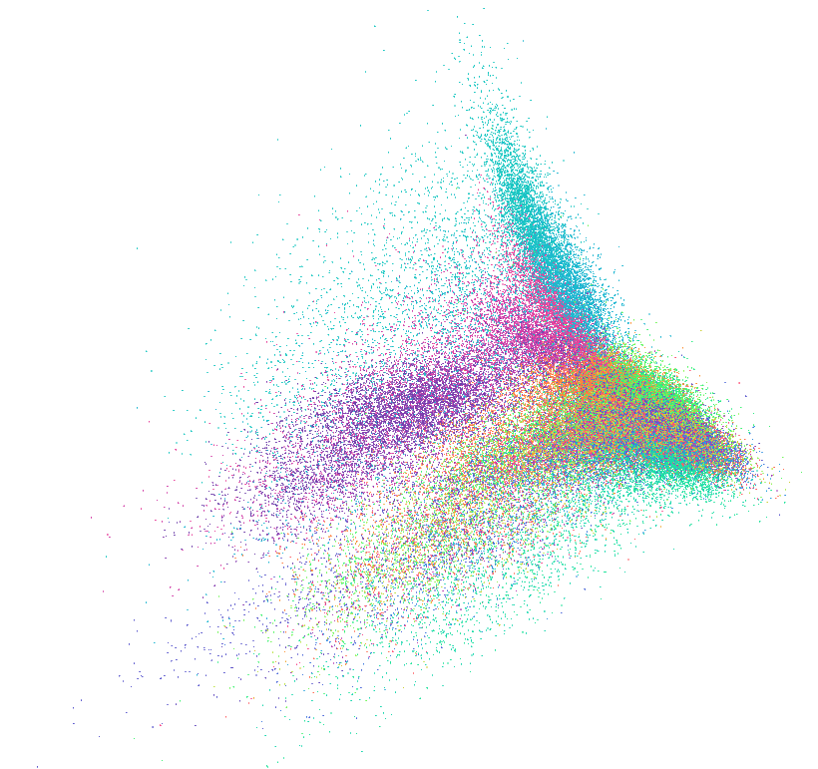
Koi Fish: Seurat full pipeline converted to h5ad
1. Introduction
http://169.237.24.172:5005/view/all_data_scaled_seurat.h5ad/
UMAP
PCA
This data was processed entirely using Seurat v5 then was converted to h5ad using the SeuratDisk package.
Missing: Batch regression, for some reason it didn’t look right when I tried it but I may have made a mistake. Otherwise, I shouldn’t regress for batch, maybe have the batches on different layers and integrate? V5 is too recent to try to do that.

Slide 10
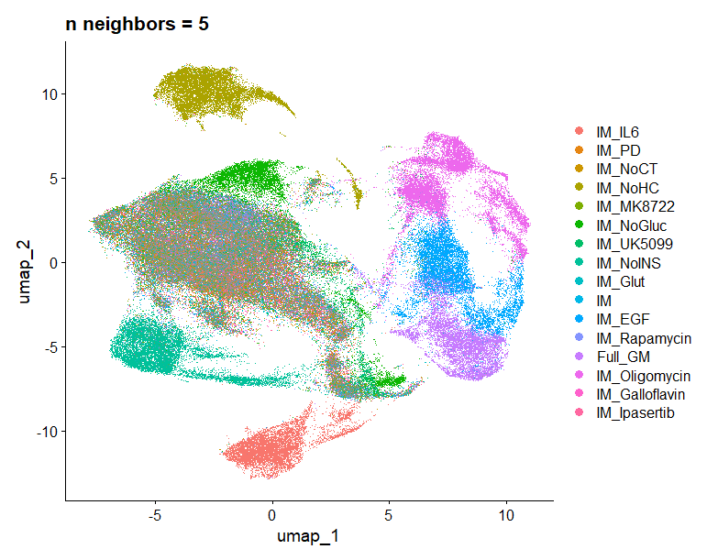
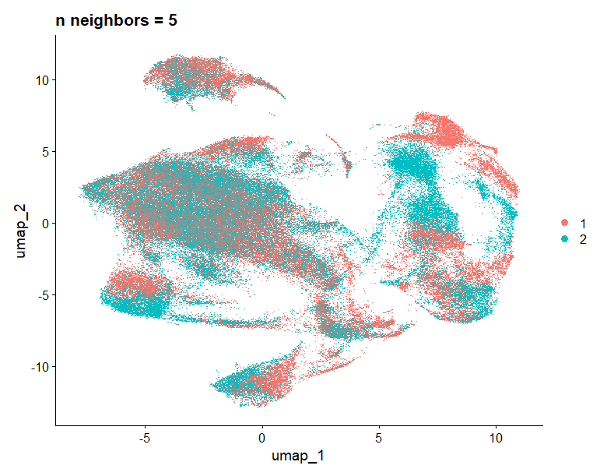
Koi Fish: After failed? regression
1. Introduction
This data is the same as previous slide but I tried regressing out batch variation. Did not work as you can see.

Slide 11
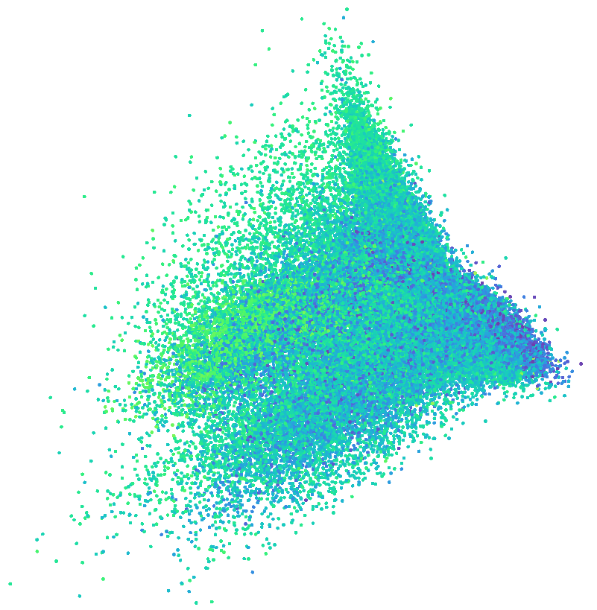
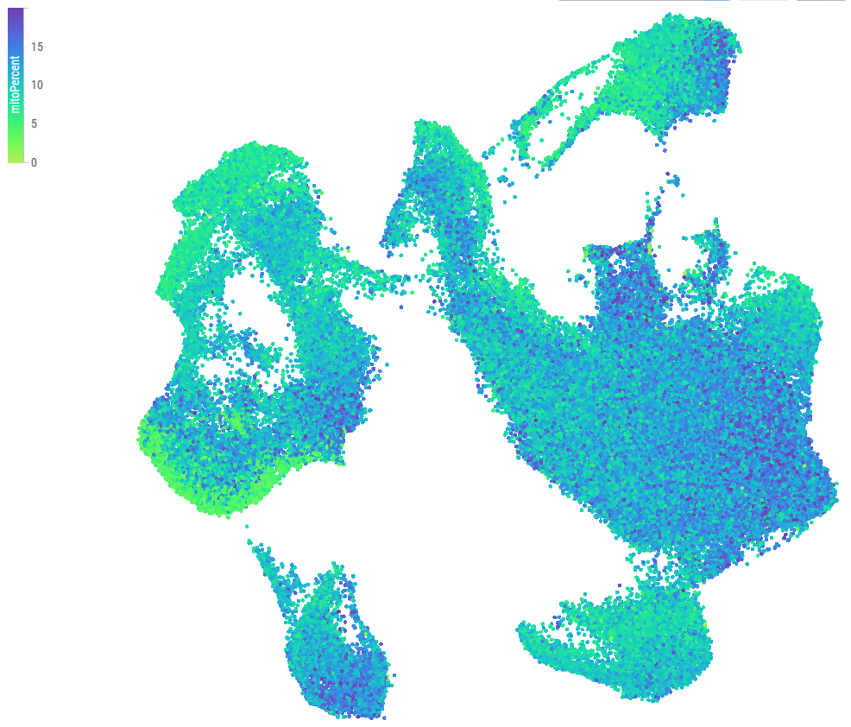
Bibbendum: scanpy pipeline v2
1. Introduction
UMAP
PCA
No cells with >20% mitochondrial genes. There is still clustering of cells with low mitochondrial content by themselves. But: Those are the EGF and full medium cells so I do not want to regress for mitopercent as it could have biological relevance.

Slide 12
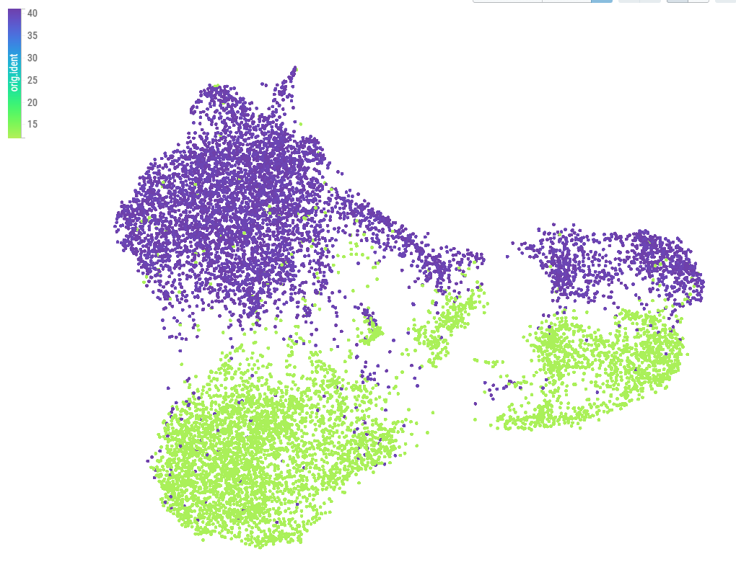
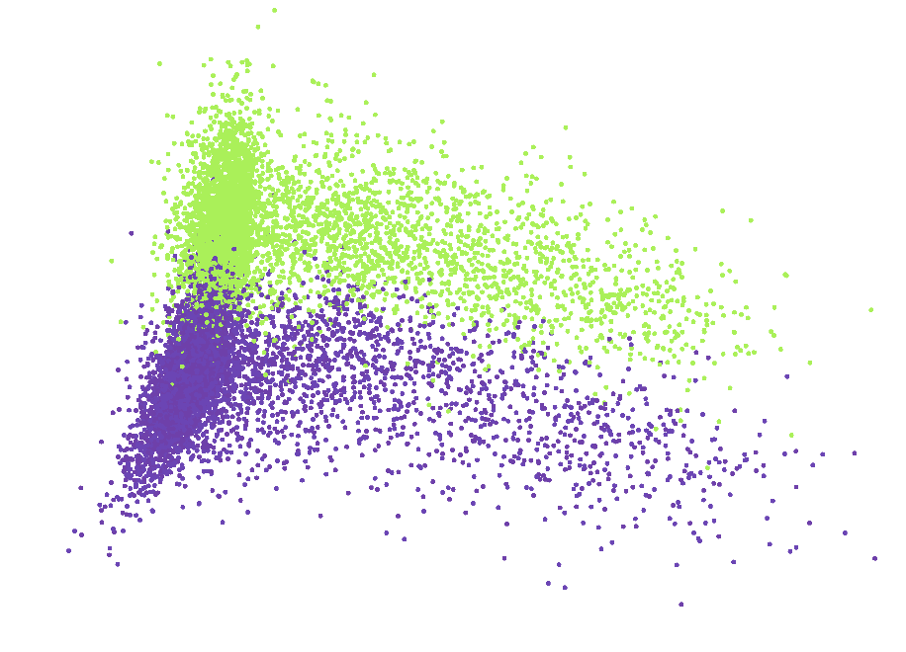

Seurat oligomycin without regression
1. Introduction
http://169.237.24.172:5005/view/IM_Oligomycin_seurat_sct.h5ad/
UMAP
PCA

Slide 13
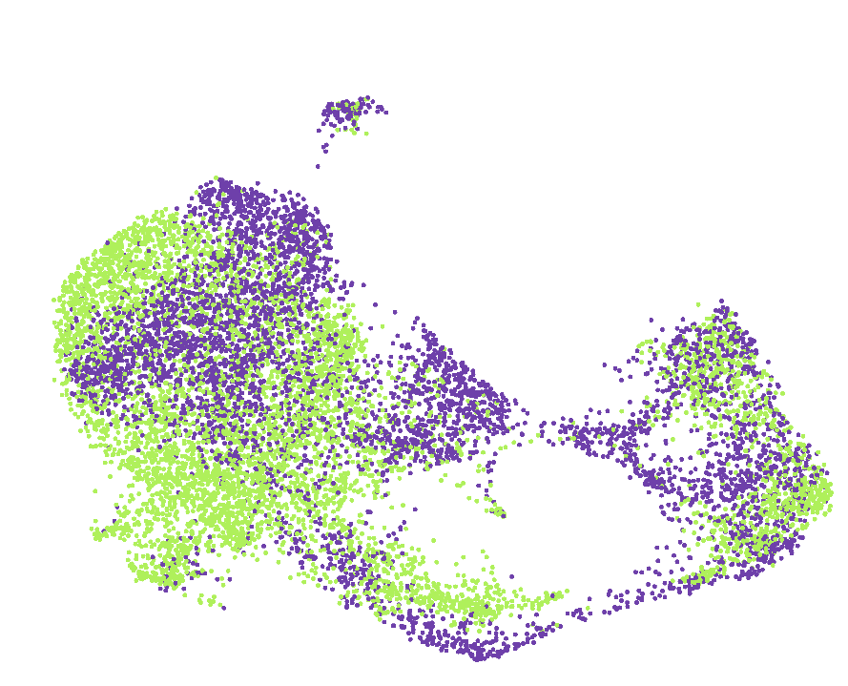
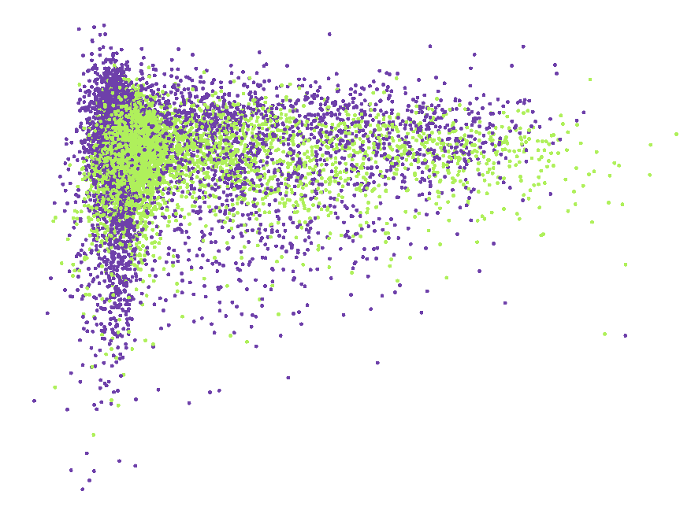
Seurat oligomycin with regression
1. Introduction
http://169.237.24.172:5005/view/IM_Oligomycin_seurat_sct.h5ad/
UMAP
PCA

Slide 14
